Slide 1
Secure Multi-Part File
Transfer Application

Slide 2
ABSTRACT
SMFT software tries to alter the originality of the file into some encrypted form and split the file into user specified size. It provides the flexibility of passing the information implementing the encryption standards and stores the information in an unreadable form. In addition, it has a log-based methodology which will take care lf any errors that may be encountered while the system i.e. under utilization. Further the application provides a user-friendly graphical user interface for the end user.

Slide 3
INTR0DUCTION
The Entire application should strive to achieve a user friendly Graphical User Interface, which need to be in a self-learning mode for the end user. The System Should provide all the functional standards of proper navigation with in the environment, which makes it possible for the users to have a smooth flow while working under the environment. The Overall system should provide proper menu based navigation for easier navigation and operation. The Application should be designed in such a way that, as soon as it starts create a Buffer and associate this buffer to some homogeneous data environment, the application should ask the user for the Encryption Key details and should start its functionality upon the logistics that are provided with in this key. The key should be designed in such a way that it prevents the unauthorized persons from stealing the information at any point of time.

Slide 4
EXISTING SYSTEM
In the existing system, data has to be transported over the network, which requires a secured format of the transfer method. Present day transactions are considered to be "un-trusted" in terms of security, i.e. they are relatively easy to be hacked. And also we have to consider the transfer the large amount of data through the network will give errors while transferring. Nevertheless, sensitive data transfer is to be carried out even if there is lack of an alternative. Network security in the existing system is the motivation factor for a new system with higher-level security standards for the information exchange.

Slide 5
Drawbacks of Existing System
Network Security

Slide 6
PROPOSED SYSTEM
The proposed system should have the following features. The transactions should take place in a secured format between various clients in the network. It provides flexibility to the user to transfer the data through the network very easily by splitting the large amount of file in to user specified size. It should also identify the user and provide the communication according to the prescribed level of security with transfer of the file requested and run the required process at the server if necessary. When responding to the client, the server should send necessary information such as User authorization and authentication information, Merging, Encryption, Decryption types and their level of hierarchy etc.

Slide 7
ADVANTAGES OF PROPOSED SYSTEM
High level security
Cost effective trasfer

Slide 8
REQUIREMENTS SPESIFICATION
Software Requirements:
Operating System : WindowsNT/2000(Client/Server).
Front-end : Java J2SDK 1.6, Swings.
Hardware Requirements:
Processor : Pentium 111 Processor With 700 MHz
Hard Disk : 20 GB HDD
RAM : 256 MB RAM
32 Bit PCI Ethernet Card

Slide 9
FEASIBILITY STUDY
TECHNICAL FEASIBILITY:
Evaluating the technical feasibility is the trickiest part of a feasibility study. This is because, at this point in time, not too many detailed design of the system, making it difficult to access issues like performance, costs on (on account of the kind of technology to be deployed) etc. A number of issues have to be considered while doing a technical analysis.
i) Understand the different technologies involved in the proposed system:
Before commencing the project, we have to be very clear about what are the technologies that are to be required for the development of the new system. Find out whether the organization currently possesses the required technologies:
Is the required technology available with the organization?
If so is the capacity sufficient?
The proposed projects uses servlet and jsp technologies of java which satisfies the requirements and are enough to implement the above web based solution. Hence the project stands for technical feasibility

Slide 10
ECONOMICAL FEASIBILITY:
Economicfeasibility attempts 2 weigh the costs of developing and implementing a new system, against the benefits that would accrue from having the new system in place. This feasibility study gives the top management the economic justification for the new system.
The proposed project developed using java technology which is an open source, hence the user need not invest more amount of money in purchasing the software. The development with the servlets and jsp is easy, hence the development cost also less as the development cost is proportional to development time.. Hence the development cost is also reduced. Hence the project stands for Economical Feasibility.

Slide 11
OPERATIONAL FEASIBILITY:
Will the system be used if it developed and implemented.
If there was sufficient support for the project from the management and from the users.
Have the users been involved in planning and development of the Project.
Will the system produce poorer result in any respect or area?
This system can be implemented in the organization because there is adequate support from management and users. Being developed in Java so that the necessary operations are carried out automatically

Slide 12
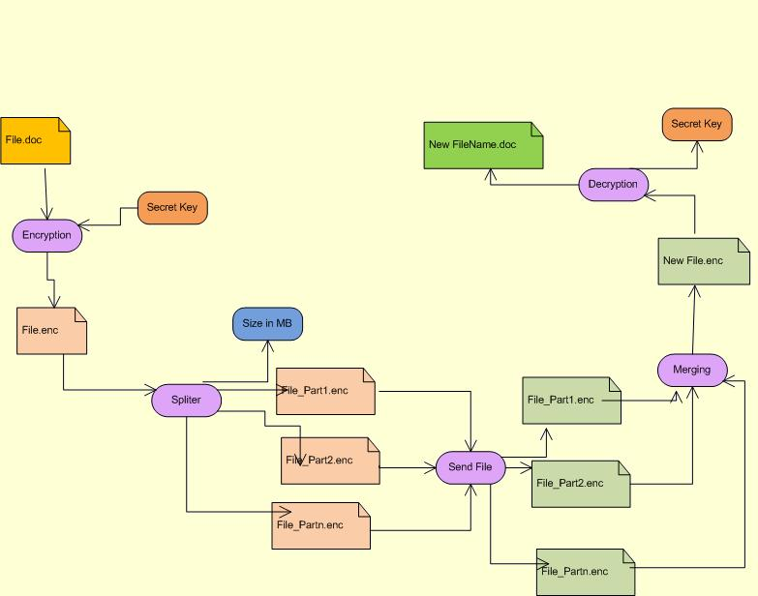
Architecture Diagram
Architecture Diagram

Slide 13
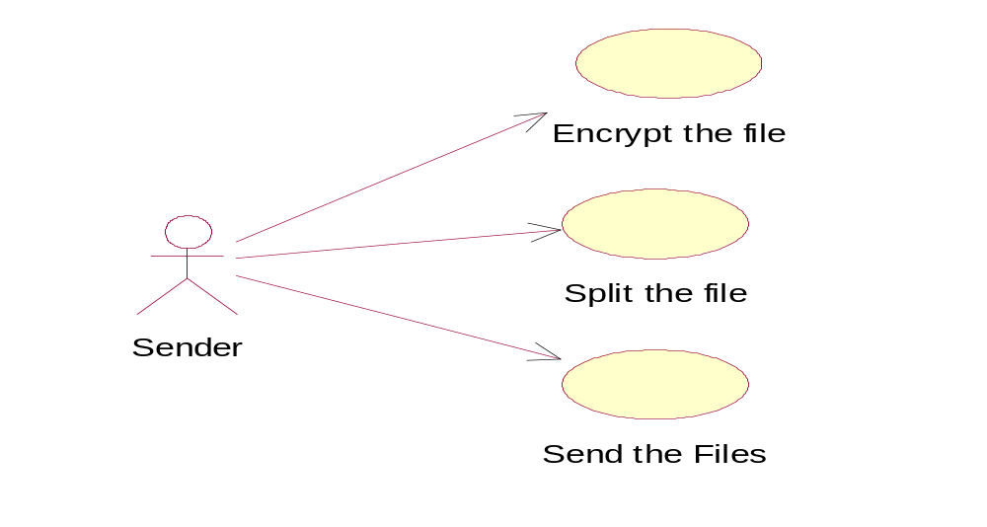
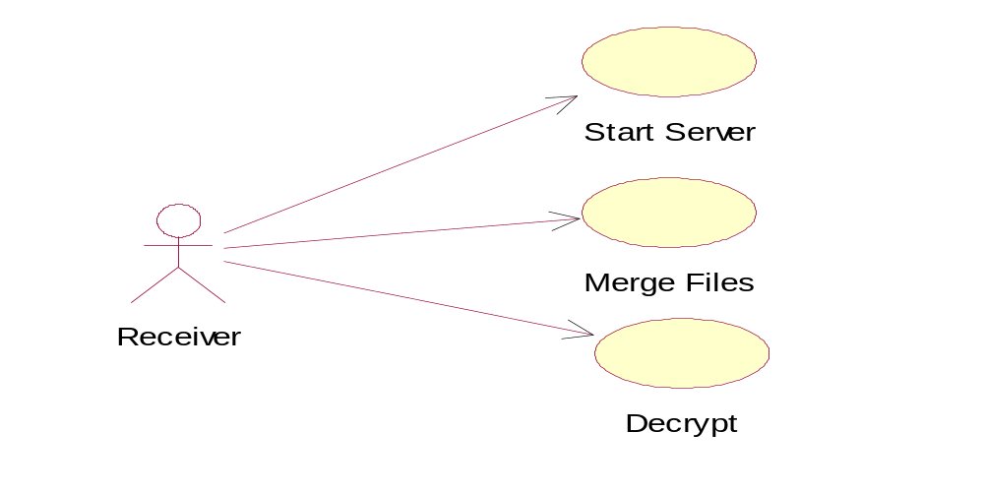
Use case Diagram
Sender:
Receiver:

Slide 14
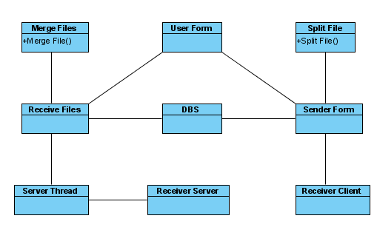
Class Diagram:

Slide 15
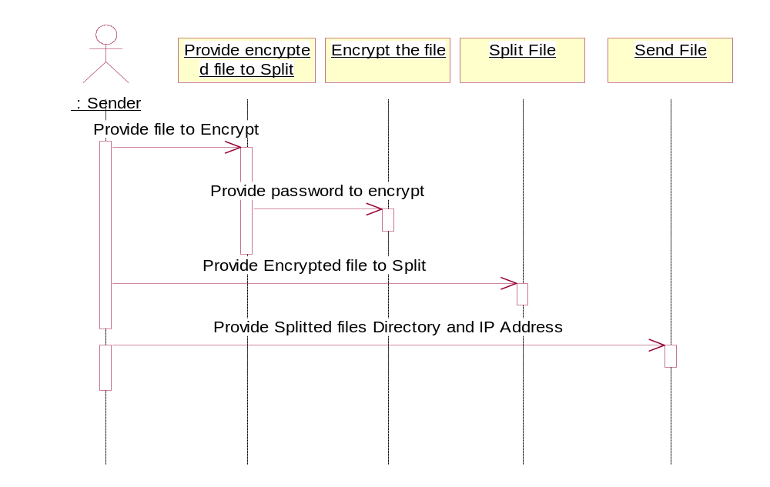
Sequence Diagrams
Sender:

Slide 16
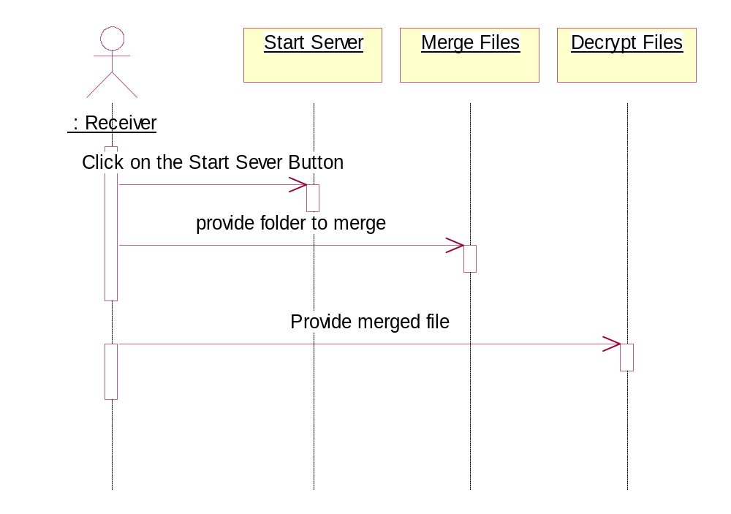
Receiver:

Slide 17
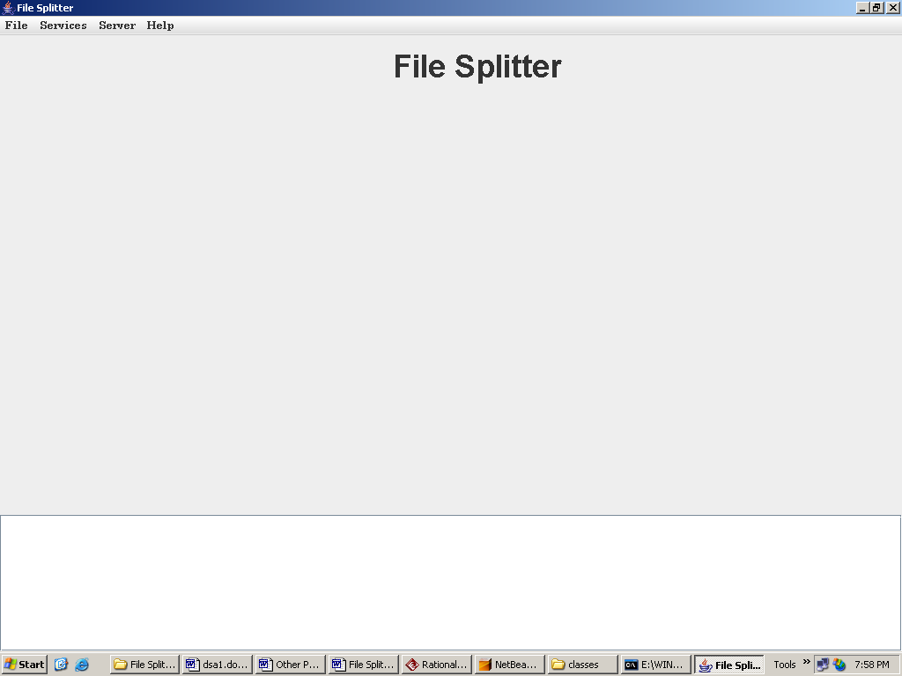
Home Page:

Slide 18
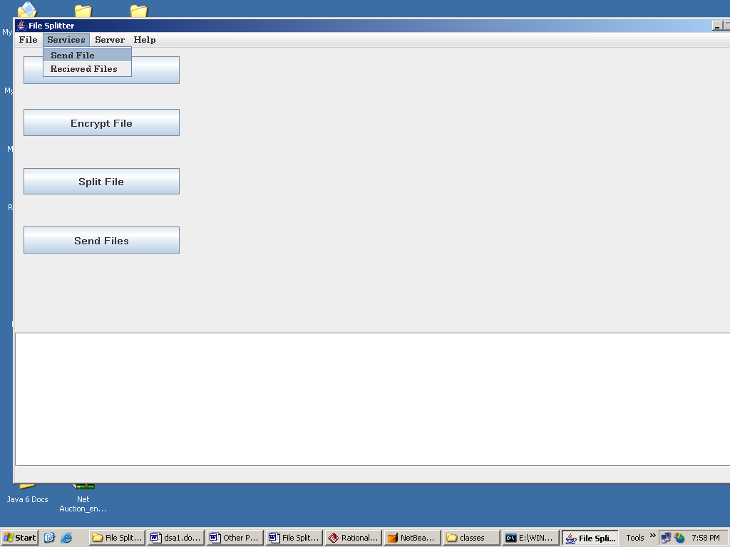

Slide 19
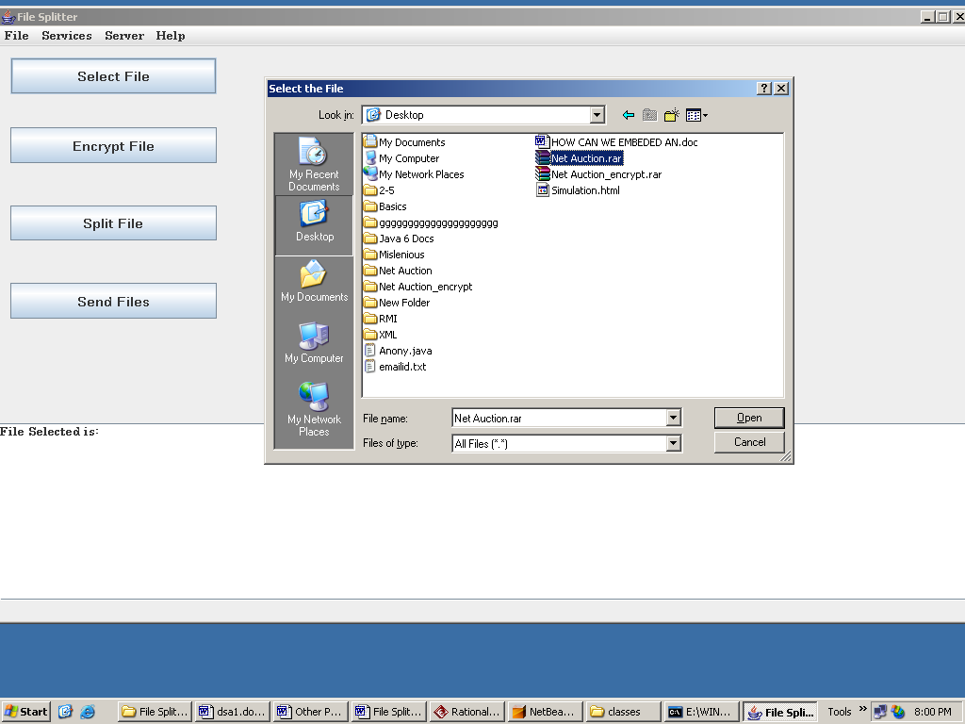
Select File:

Slide 20
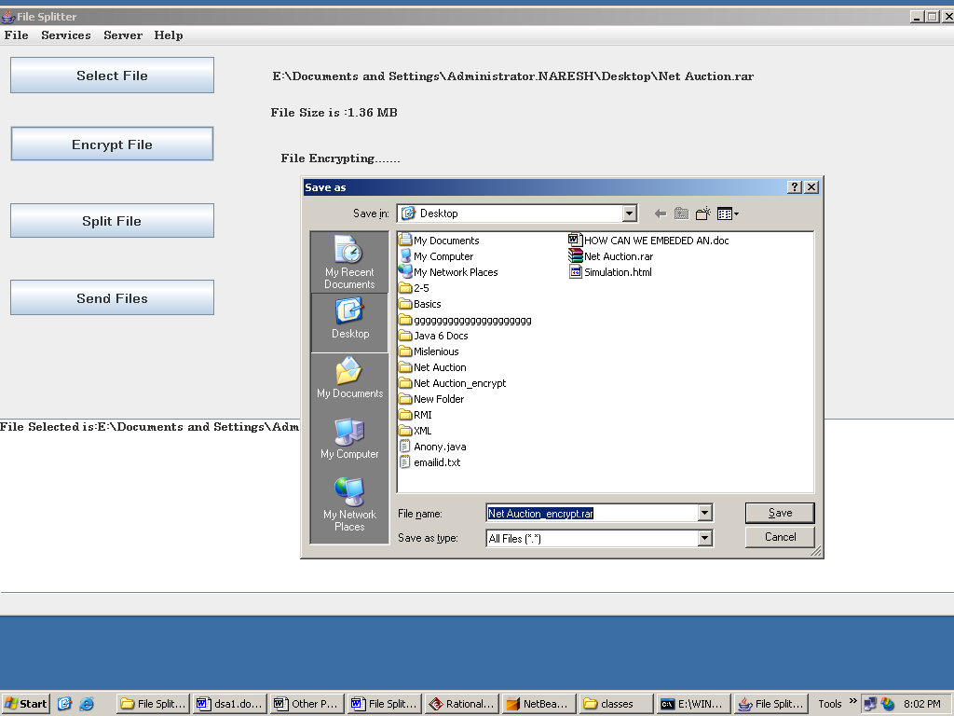
Save Encrypted File:

Slide 21
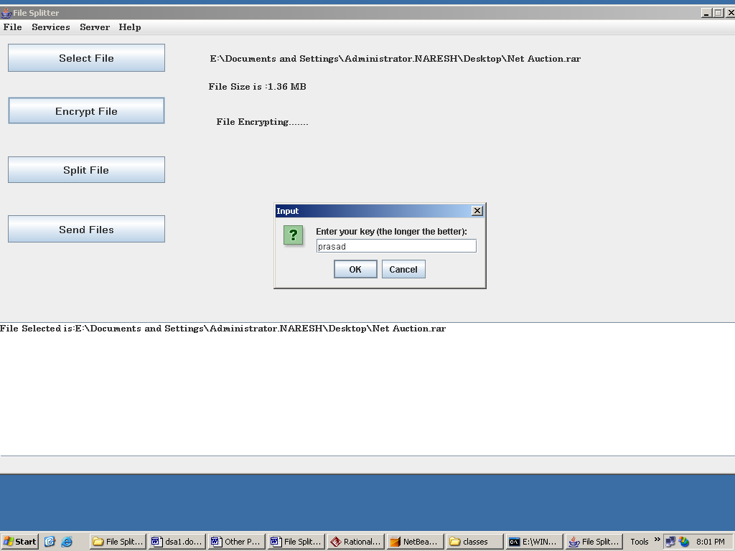
Encrypt File:

Slide 22
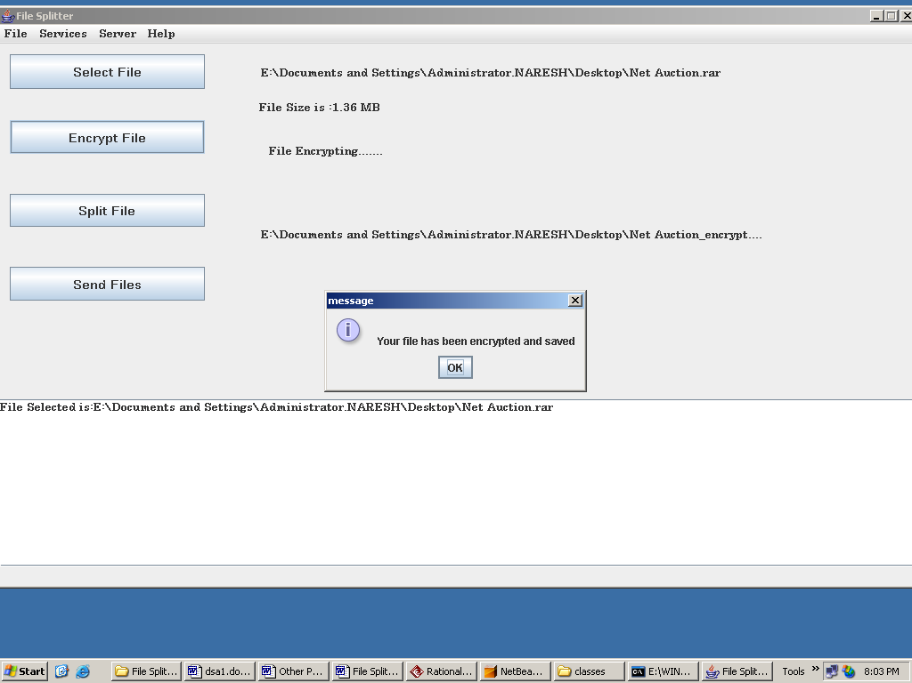

Slide 23
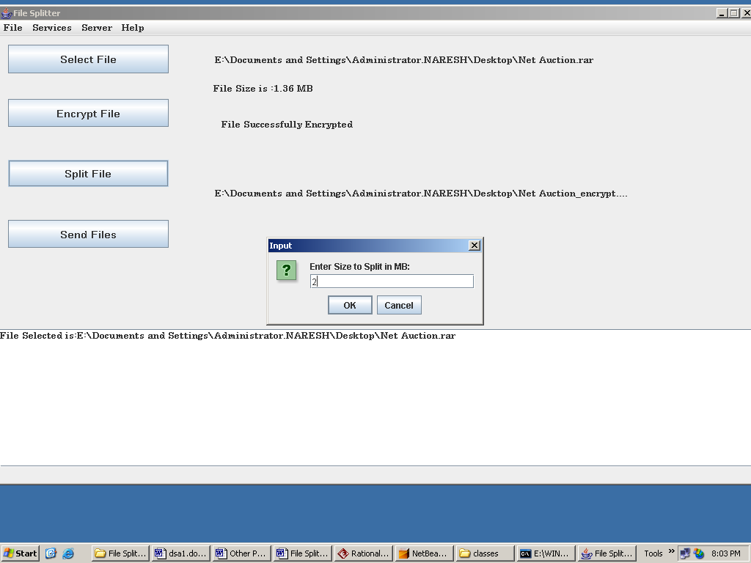
Split File:

Slide 24
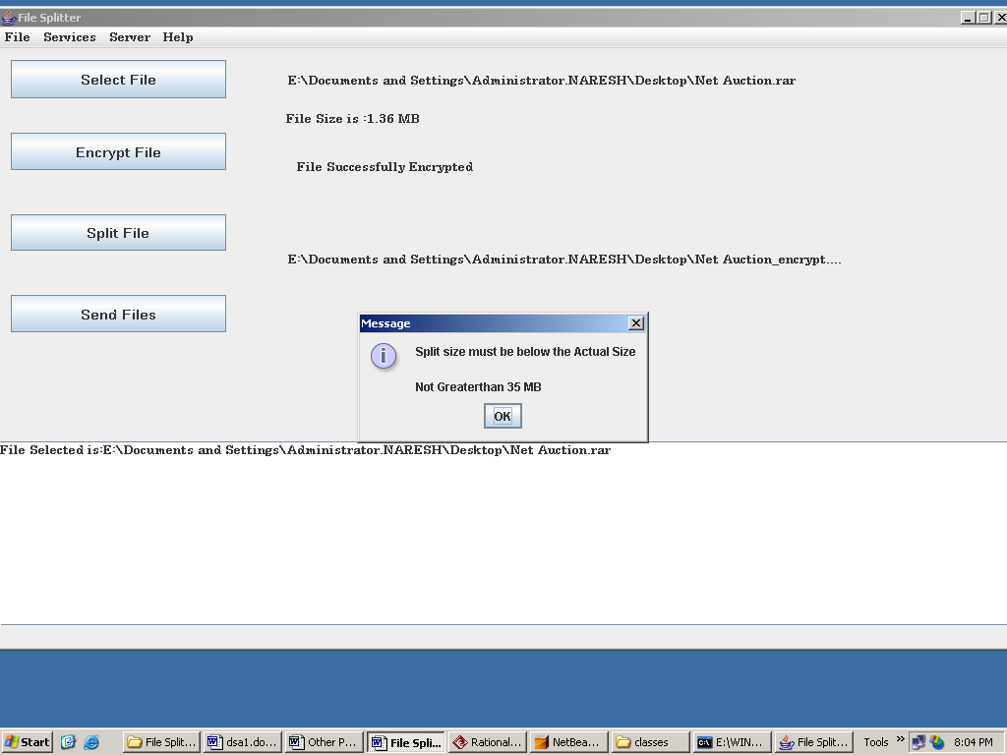

Slide 25
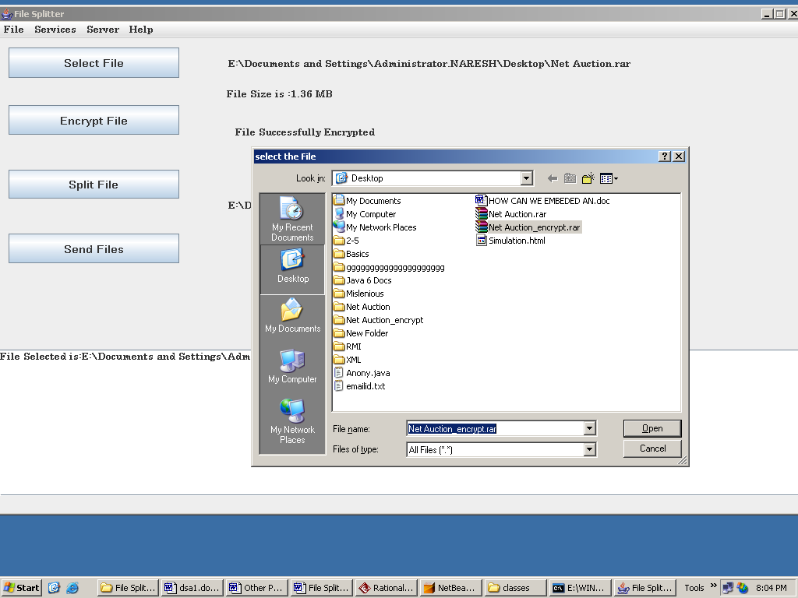
Select Encrypted File to split:

Slide 26
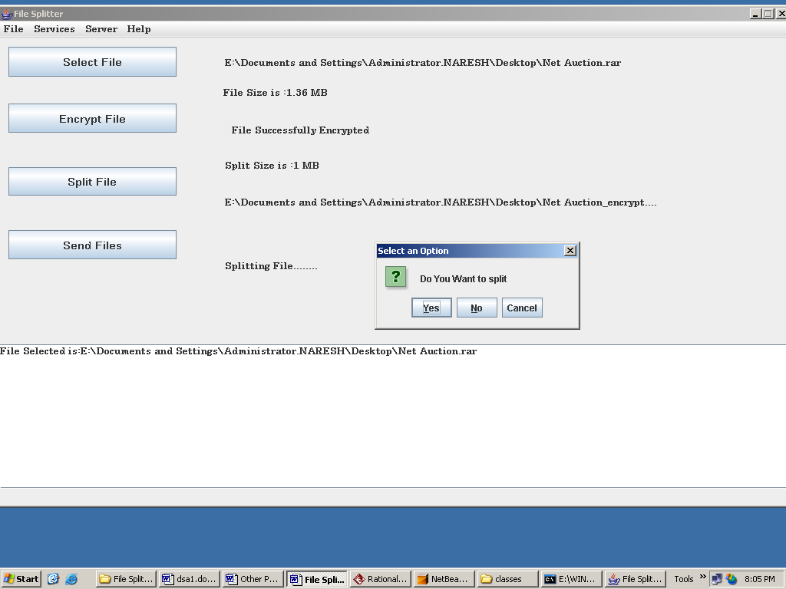

Slide 27
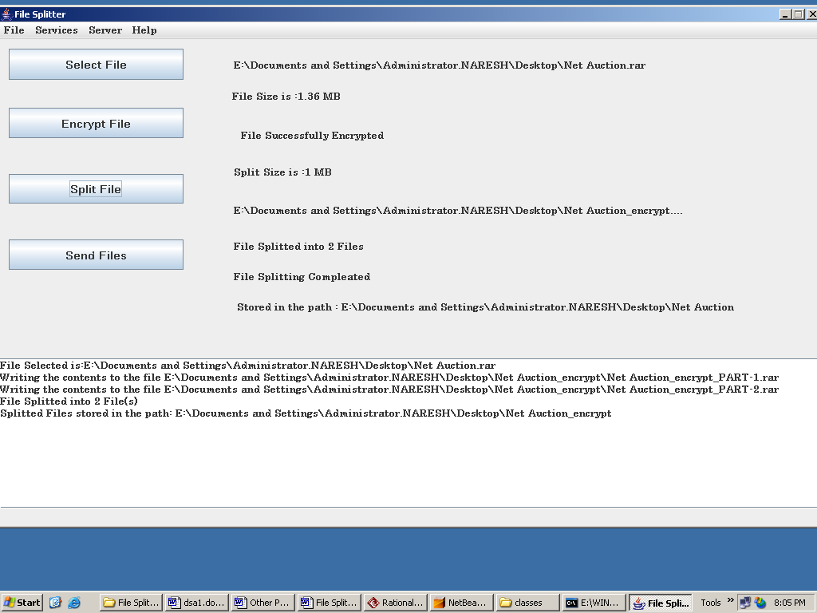

Slide 28
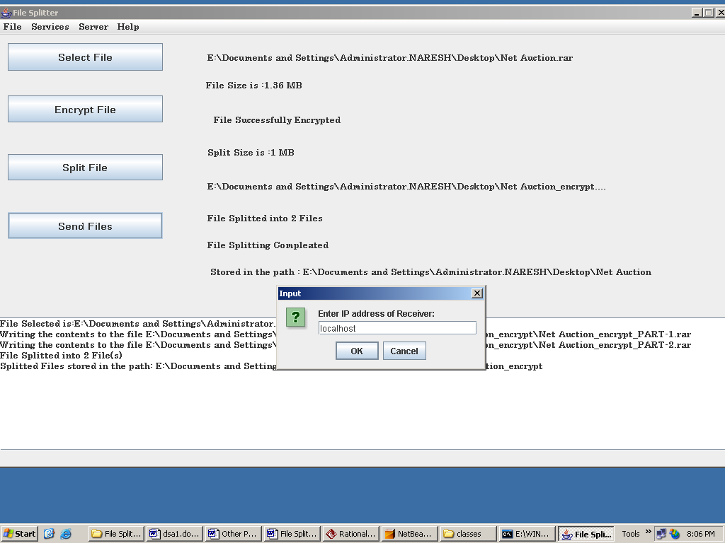
Sent Files:

Slide 29
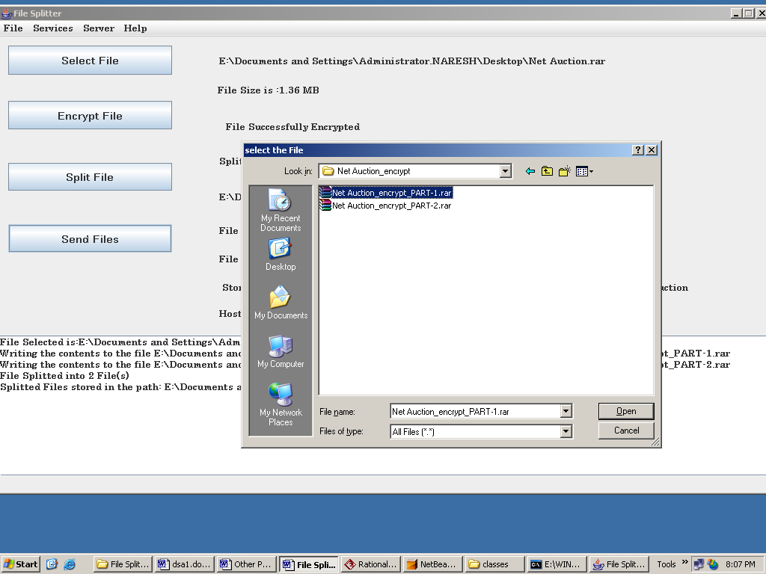
Select File To Send:

Slide 30
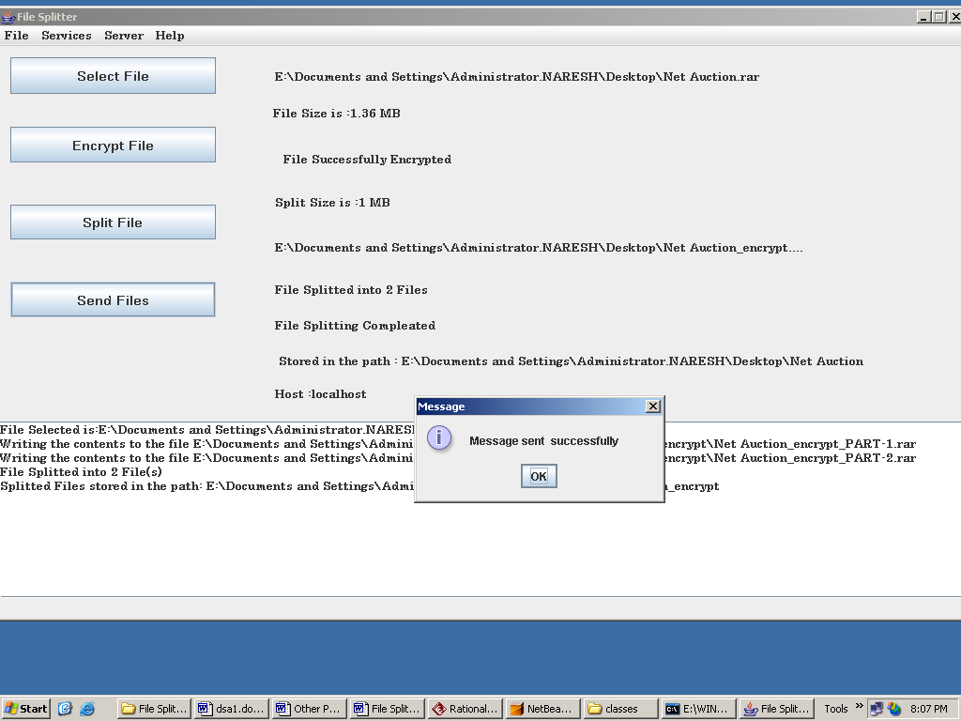

Slide 31
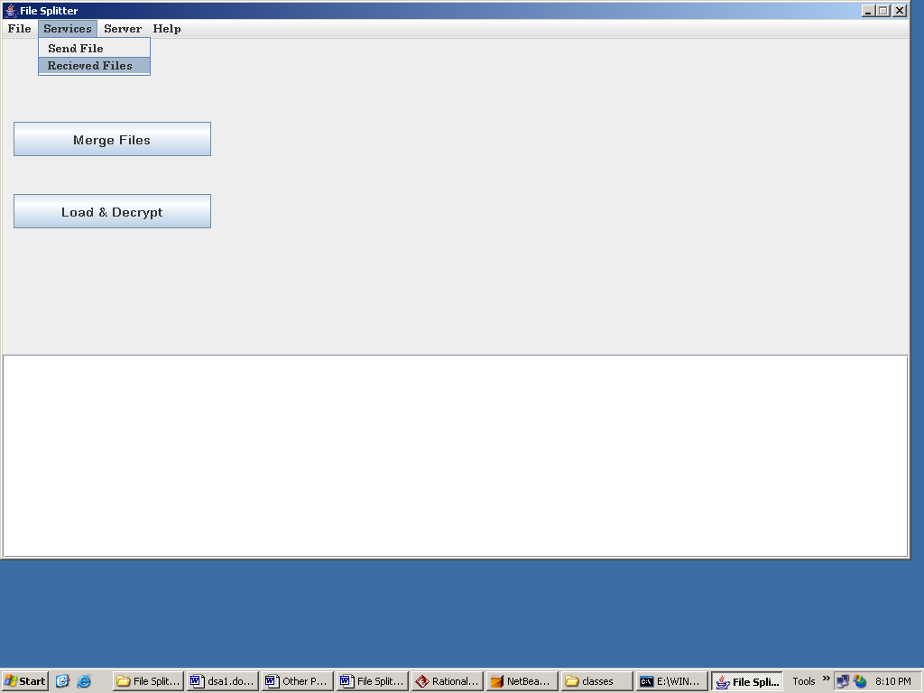
Receiver:

Slide 32
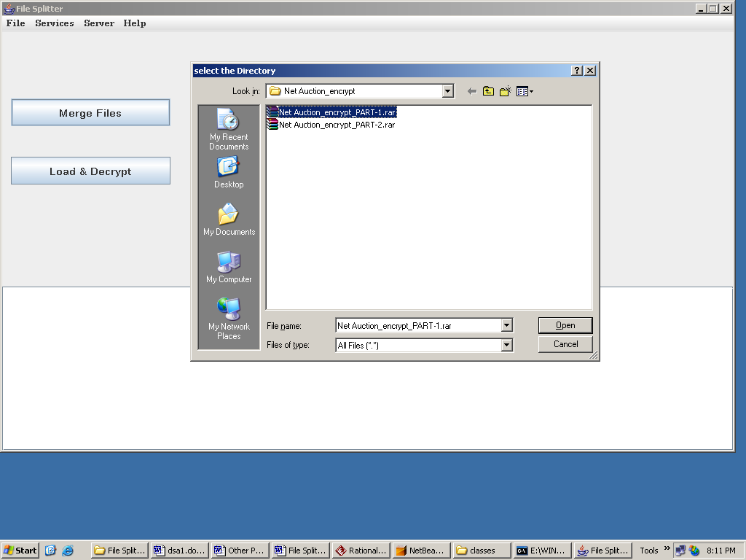
Select Directory to Merge:

Slide 33
UserForm.java:
package User_GUI;
import Receiver.*;
import Sender.SendFile;
import javax.swing.JOptionPane;
/**
*
* @author Administrator
*/
public class UserForm extends javax.swing.JFrame {
Thread t;
/** Creates new form UserForm */
public UserForm() {
initComponents();
}
/** This method is called from within the constructor to
* initialize the form.
* WARNING: Do NOT modify this code. The content of this method is
* always regenerated by the Form Editor.
*/
// <editor-fold defaultstate="collapsed" desc="Generated Code">//GEN-BEGIN:initComponents
private void initComponents() {
jScrollPane1 = new javax.swing.JScrollPane();
jTextArea1 = new javax.swing.JTextArea();
jLabel1 = new javax.swing.JLabel();
jMenuBar1 = new javax.swing.JMenuBar();
jMenu3 = new javax.swing.JMenu();
jMenuItem5 = new javax.swing.JMenuItem();
jMenu1 = new javax.swing.JMenu();

Slide 34
jMenuItem1 = new javax.swing.JMenuItem();
jMenuItem2 = new javax.swing.JMenuItem();
jMenu4 = new javax.swing.JMenu();
jMenuItem7 = new javax.swing.JMenuItem();
jMenu2 = new javax.swing.JMenu();
jMenuItem4 = new javax.swing.JMenuItem();
setDefaultCloseOperation(javax.swing.WindowConstants.EXIT_ON_CLOSE);
setTitle("File Splitter");
jTextArea1.setColumns(20);
jTextArea1.setEditable(false);
jTextArea1.setRows(5);
jScrollPane1.setViewportView(jTextArea1);
jLabel1.setFont(new java.awt.Font("Arial", 1, 36));
jLabel1.setText("File Splitter");
jMenu3.setText("File");
jMenu3.setFont(new java.awt.Font("Century", 1, 12));
jMenuItem5.setFont(new java.awt.Font("Century", 1, 12));
jMenuItem5.setText("Exit");
jMenuItem5.addActionListener(new java.awt.event.ActionListener() {
public void actionPerformed(java.awt.event.ActionEvent evt) {
jMenuItem5ActionPerformed(evt);
}
});
jMenu3.add(jMenuItem5);
jMenuBar1.add(jMenu3);
jMenu1.setText("Services");
jMenu1.setFont(new java.awt.Font("Century", 1, 12));
jMenu1.addActionListener(new java.awt.event.ActionListener() {

Slide 35
public void actionPerformed(java.awt.event.ActionEvent evt) {
jMenu1ActionPerformed(evt);
}
});
jMenuItem1.setFont(new java.awt.Font("Century", 1, 12));
jMenuItem1.setText("Send File");
jMenuItem1.addActionListener(new java.awt.event.ActionListener() {
public void actionPerformed(java.awt.event.ActionEvent evt) {
jMenuItem1ActionPerformed(evt);
}
});
jMenu1.add(jMenuItem1);
jMenuItem2.setFont(new java.awt.Font("Century", 1, 12));
jMenuItem2.setText("Recieved Files");
jMenuItem2.addActionListener(new java.awt.event.ActionListener() {
public void actionPerformed(java.awt.event.ActionEvent evt) {
jMenuItem2ActionPerformed(evt);
}
});
jMenu1.add(jMenuItem2);
jMenuBar1.add(jMenu1);
jMenu4.setText("Server");
jMenu4.setFont(new java.awt.Font("Century", 1, 12));
jMenu4.addActionListener(new java.awt.event.ActionListener() {
public void actionPerformed(java.awt.event.ActionEvent evt) {
jMenu4ActionPerformed(evt);
}
});

Slide 36
Testing:
Black box Testing: is the testing process in which tester can perform testing on an application without having any internal structural knowledge of application.
Usually Test Engineers are involved in the black box testing.
White box Testing: is the testing process in which tester can perform testing on an application with having internal structural knowledge.
Usually The Developers are involved in white box testing.
Gray Box Testing: is the process in which the combination of black box and white box tonics’ are used.

Slide 37
UNIT TESTING:
During the implementation of system module of the system was tested separately to uncover errors with its boundaries.
FUNCTIONALITY TESTING:
To ensure that each module performs intended functions only those correctness and robustness.
BOUNDARY CONDITION TESTING:
Boundary conditions as in case of generating sequences were tested to ensure that the module operates properly at boundaries established to limit or restrict processing.

Slide 38
SUMMARY :
This project takes place in a secured format between various clients in the network. It provides flexibility to the user to transfer the data through the network very easily by splitting the large amount of file in to user specified size. It should also identify the user and provide the communication according to the prescribed level of security with transfer of the file requested and run the required process at the server if necessary. When responding to the client, the server should send necessary information such as User authorization and authentication information, Merging, Encryption, Decryption types and their level of hierarchy etc.
This application software has been computed successfully and was also tested successfully. It is user friendly, and has required options, which can be utilized by the user to perform the desired operations.

Slide 39
CONCLUSION :
The task given to us performed by keeping in mind the goals we have to achieve, these are to provide user-friendliness. This project SMFT is mainly useful for “software consultants”.
The SMFT is excepted to function as per the requirements and we expect that it will satisfy the users.

Slide 40
FUTURE ENHANCEMENT :
It is not possible to develop a system that makes all the requirements of the user. User requirements keep changing as the system is being used. Some of the future enhancements that can be done to this system are:
As the technology emerges, it is possible to upgrade the system and can be adaptable to desired environment.
Because it is based on object-oriented design, any further changes can be easily adaptable.
Based on the future security issues, security can be improved using emerging technologies.

Slide 41
BIBILOGRAPHY:
S NO | NAME | AUTHOR | PUBLICATION
1 2 3 4 | Core JavaTM Volume I-Fundamentals 7th Edition JavaTM The Complete Reference -5th Edition Software Engineering The Unified Modeling Language | Cay S. Hortsman Patrick Naughton, Herbert Schieldt Roger S.Pressman Grady Booch,James Rumbaugh,Ivar Jacobson | Pearson Education-Sun Microsystems Tata McGraw Hill International Edition McGraw Hill International Edition Pearson Education

Slide 42
Thank You………………

